Slide 1

Project Guide
Mrs. Prajakta Patil
Course Coordinator
Mr. Bhanu Pratap Singh
Name | PRN
ROHIT RAMAKANT MAGAR | 210930920023
SHUBHAM PUNA PATIL | 210930920034
ANITA ASHOK JADHAV | 210930920004
SARITA BALU TAYDE | 210930920056
CHETAN BHARAT PATIL | 210930920007

Slide 2

E-COMMERCE WEB APPLICATION.

Slide 3
What is E-commerce
E-Commerce commonly known as Electronic commerce. It consist of buying and selling product and services over an electronic systems such as the internet and other computer networks.
It is the process of making money transfers, and transferring data over an electronic medium (Internet).
E-Commerce allows people to do business without the constraint of distance and time.

Slide 4
What we do ?
Our System is an e-commerce website from where people can buy products online.
Admin monitors the activity of the users and checks the transactions.

Slide 5
Features
Menu
Catalog Browsing
Category List
Product List
Catalog Management
Product Browsing
Product Reviews
Shopping Cart Checkout
Auto generated bill

Slide 6
Sources we used.
Languages
React- Frontend
Spring Boot- Backend
MySQL- Database

Slide 7
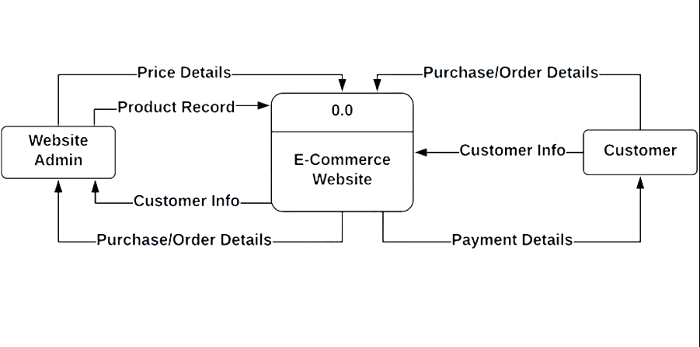
Data Flow Diagram

Slide 8
Advantages of E-commerce
Faster buying/selling procedure, as well as easy to find products.
Buying/selling 24/7.
More reach to customers, there is no theoretical geographic limitations.
Low operational costs and better quality of services.
No need of physical company set-ups.
Easy to start and manage a business.

Slide 9
Disadvantages of E-commerce
Unable to examine products personally.
Not everyone is connected to the Internet.
Mechanical failures can cause unpredictable effects on the total processes.

Slide 10
Future plans
We are thinking of some modifications and adding some advanced new features in out system. Some of them are -
GUI modification (more user friendly).
Users can sell their products.
Users can signup / login using their social media account such as Facebook , Google etc.

Slide 11
Thank You !

